Slide 1


Microsoft Connector
Your digital careers assistant

Slide 2


Hi!
I’m ‘Name’
My Role at Microsoft
Why am I here today?
My job title is ‘Job Title’ and I work for Microsoft.
Include a summary of your role and the team you are a part of.
What is the function of your team at Microsoft? What is the function of your role? What does your day to day look like at work?
To introduce you to the Microsoft Connector. A new, informative portal that will support your career journey into AI Careers & much more!
20%
www.getintodigital.co.uk

Slide 3

What does the word Career mean to you?
Do you know what you want to do in the future?
www.getintodigital.co.uk

Slide 4

You
Career
Can any of you guarantee you will always follow one path?
www.getintodigital.co.uk

Slide 5

There are so many options out there, so many career choices & many different ways to get there.
With many different platforms available everyday of the year & all available 24hrs a day, how do you know if you’re missing out on the right information, looking on the right website, applying for the right apprenticeship/job/internship?
This part can get even more confusing than the first decision of an actual career choice!!
Introducing, Microsoft Connector The UK hub for digital careers

Slide 6








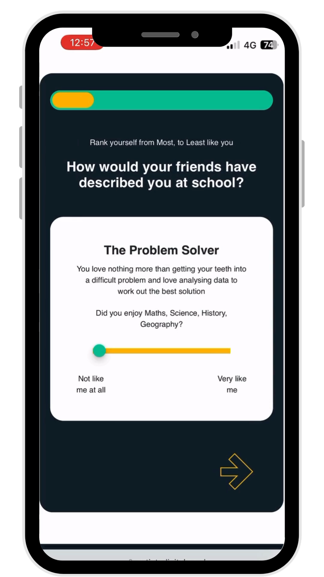


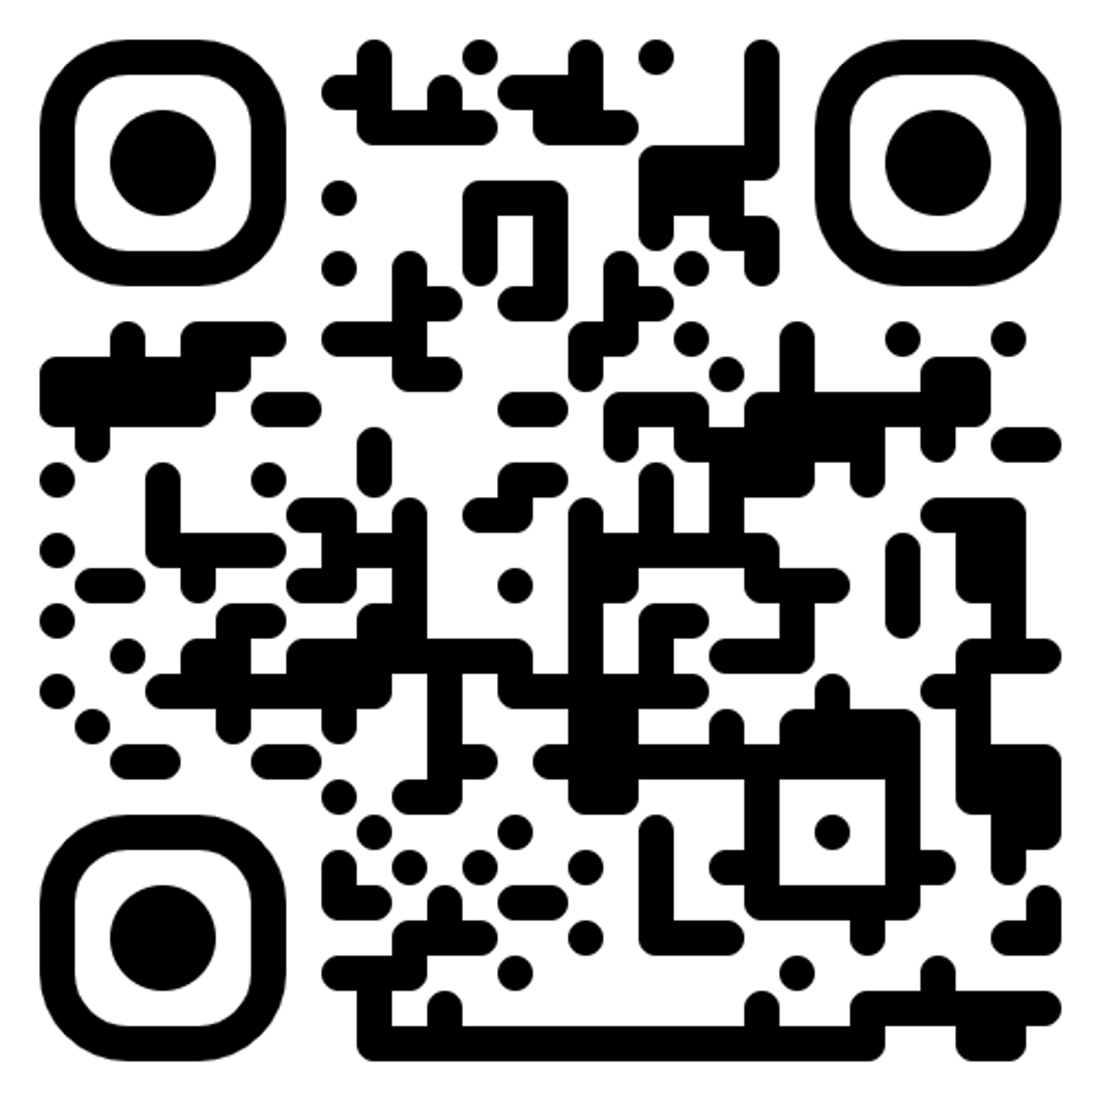
Your journey to a digital career
Learn more about employers recruiting digital roles
Read stories from people just like you, starting out on their digital career
Read about routes into digital to find the path for you
Thinking about your next step, interested in digital but not sure where to start? Microsoft Connector is the place to be for all things digital careers. With job opportunities, Digital Career Copilot, Careers quiz and learning modules, there’s all you need to take that next step – whatever that looks like for you!
Expand your digital skills with a Microsoft Learn module
Search for a live opportunity in digital and apply
Discover digital careers you never knew existed
Your AI assistant for all things digital careers- speak to your Copilot, and get advice on how start your journey
Scan me to register
Take the Digital Careers Quiz and find what career path could be a fit for your personality type
www.getintodigtal.co.uk

